Slide 1



Applied Data Analysis (CS401)
Lecture 12
Handling network data
6 Dec 2023
Robert West
Notes:
2020: 6 minutes too long (with a 15-min break and a long game of Wikispeedia)
2021: 3 minutes too long (14-min break; long and failed game of Wikipeedia [target Rembrandt])
2022: 3 minutes too long (14-min break; short game of Wikipeedia)
2023: 6 minutes too long (15-min break; long, but successful game of Wikispeedia)

Slide 2
Announcements
Homework H2 is being graded
Feedback to be released next week
Final project milestone P3 due on Fri 22 Dec 2023
Friday’s lab session:
Project office hour (on Zoom)
Second-to-last project office hour before due date
To secure your team’s personal time slot, follow protocol described in this Ed post
Exercises on handling networks (in BCH 2201)
In parallel to office hour

Slide 3
Give us feedback on this lecture here: https://go.epfl.ch/ada2023-lec12-feedback
What did you (not) like about this lecture?
What was (not) well explained?
On what would you like more (fewer) details?
…

Slide 4
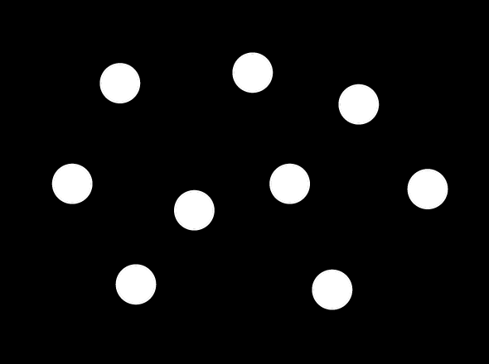
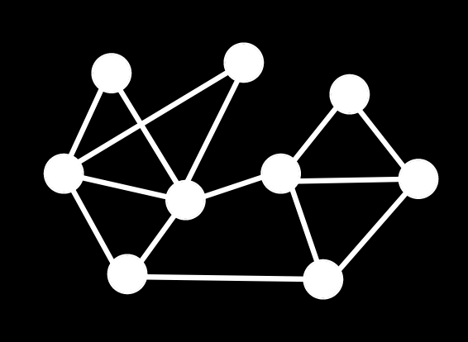
Beyond flat tables
Marriages
People
husband_id | wife_id
1 | 34
2 | 5
2 | 87
… | …
id | name | age
1 | Bob | 36
2 | Willy | 32
… | … | …
Notes:
So far in this course: mostly tabular data
One row per entity
[CLICK] Tables may link several entities (rows of other tables) to each other
Still everything in “table world”
But often not the most natural way to think about the data
[CLICK] Left table specifies nodes in a graph; [CLICK] right table, edges
If data is a network, makes sense to model it directly that way
tables → graphs

Slide 5
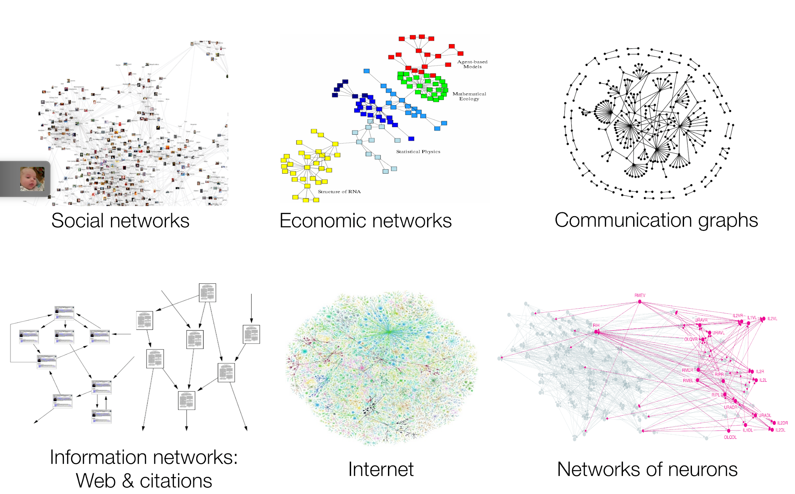
Examples
Notes:
Social network: many different semantics possible for edges (knows, loves, trusts, endorses, …)

Slide 6
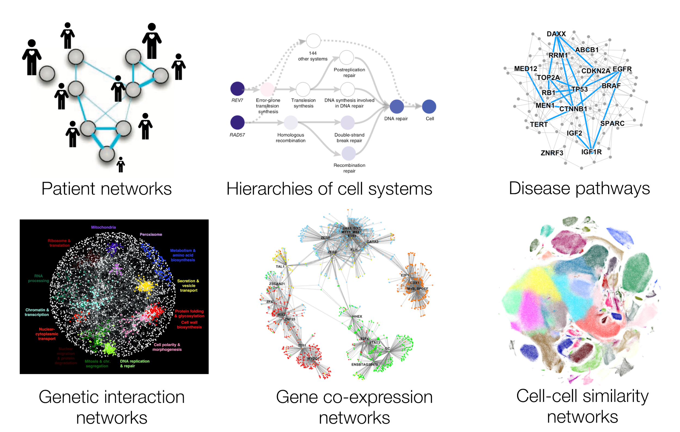
Examples
Notes:
Even when zooming into one particular domain (health), many systems can be modeled as networks

Slide 7
Networks as graphs
Network: a real-world system of dependent variables, e.g.,
WWW is a network of hyperlinked documents
Society is a network of individuals linked by family, friendship, professional ties
Metabolic network is sum of all chemical reactions in a cell
Graph: mathematical abstraction for describing networks
In practice, “network” and “graph” are used interchangeably
You can make a graph out of almost anything (e.g., connect all people whose name starts with the same letter), so must ask: Does this graph correspond to a meaningful network?

Slide 8
Today’s lecture
Part 1: Types of graphs
Part 2: Representing graphs on computers
Part 3: Properties of real-world networks
Part 4: Measuring node importance

Slide 9
Part 1:
Types of graphs

Slide 10
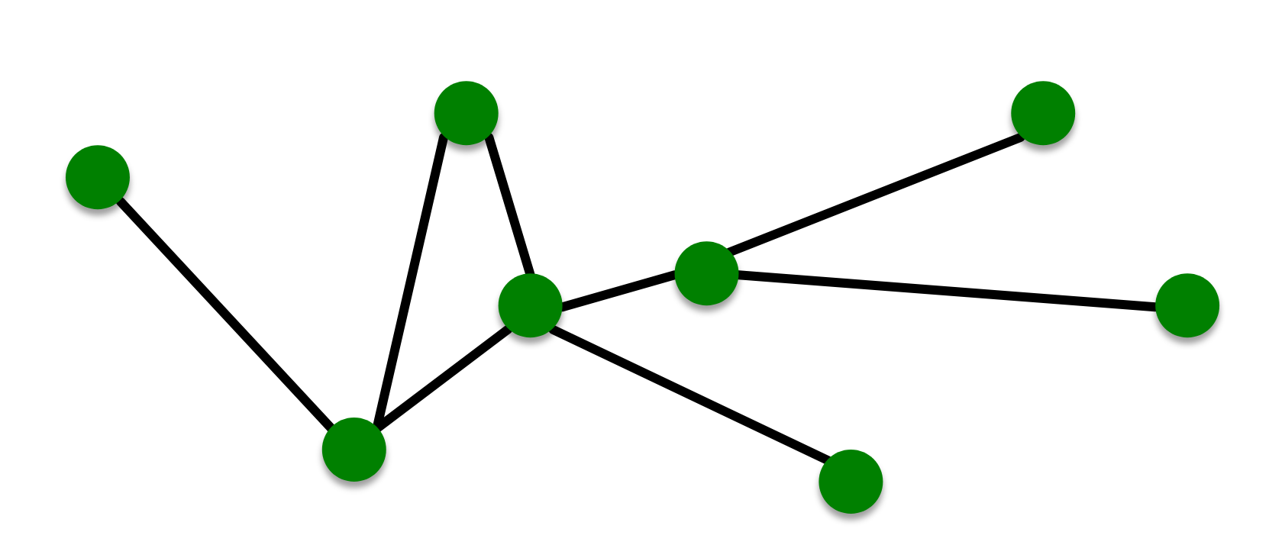
Most basic type: undirected graphs
Entities: nodes/vertices V
Relationships/interactions: edges/links E
Entire system: graph G = (V, E)

Slide 11
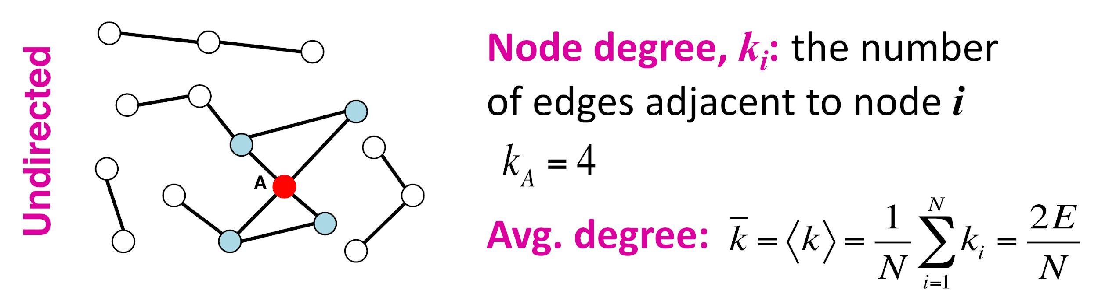
Node degree
Notes:
“Number of neighbors”

Slide 12
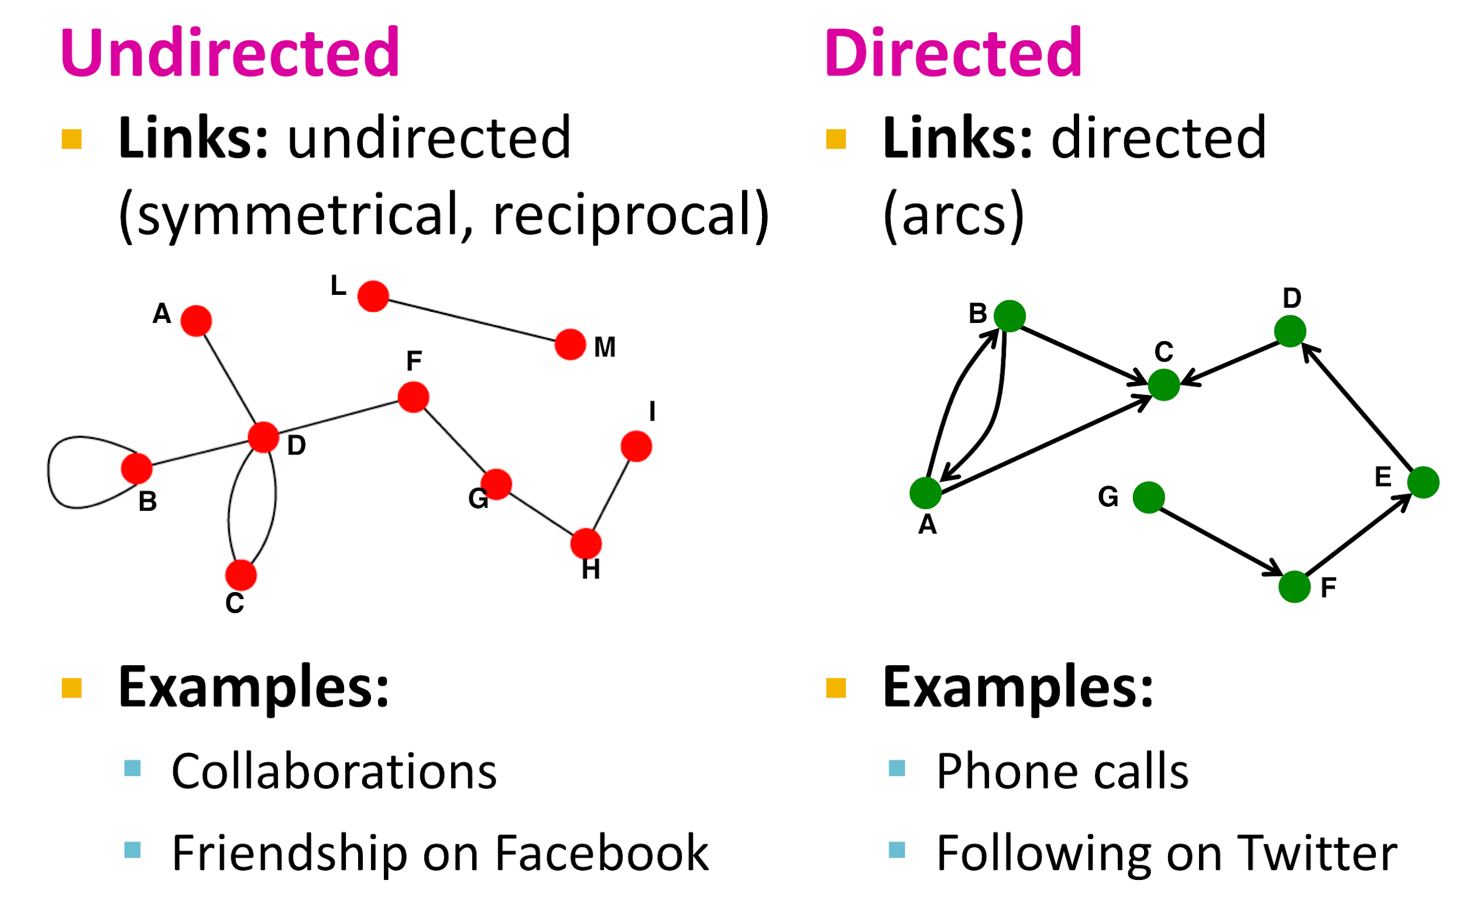
Types of graphs: undirected vs. directed
Notes:
…
Which one is appropriate depends on underlying real-world network
Point out on left: self-loop (B, B), multi-edge (C, D)

Slide 13
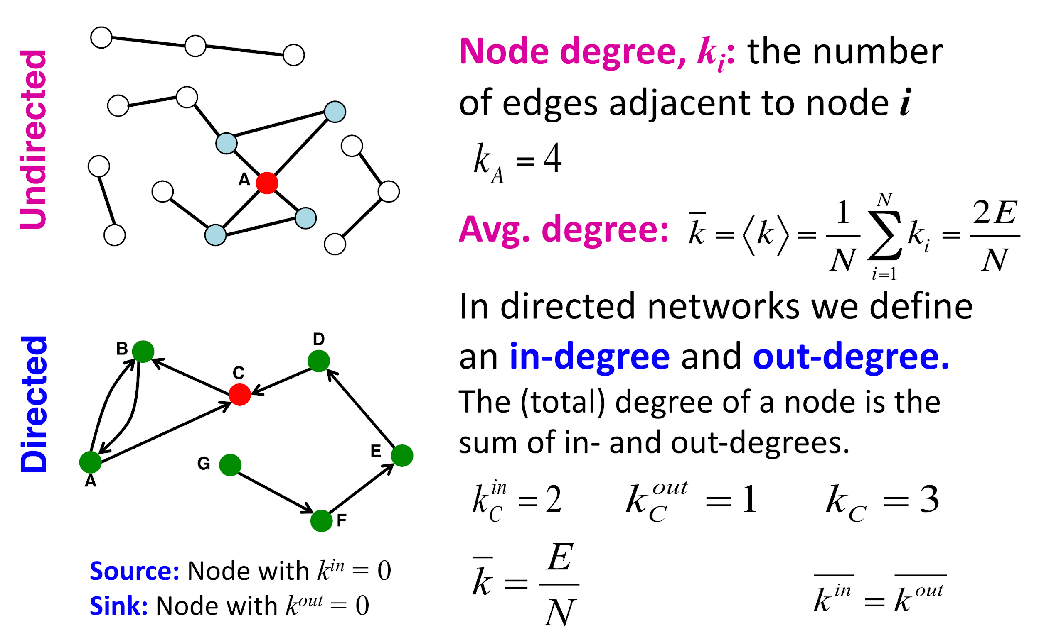


Average node degree
POLLING TIME
Scan QR code or go to https://web.speakup.info/room/join/66626
Notes:
Avg node degree: an important statistic of a graph
Compact expression for average degree in undirected graph?
In terms of total number of nodes (N) and edges
What expression describes the average node degree? E = number of edges N = number of nodes (A) E*N
(B) E/N
(C) 2E/N
(D) log(N)/N
(E) N

Slide 14
Average node degree
Notes:
For directed graph?
[CLICK] Avg. indegree = avg. outdegree
Because every link increases both total in- and out-degrees by 1 each
Avg. total degree: same as for undir graph

Slide 15
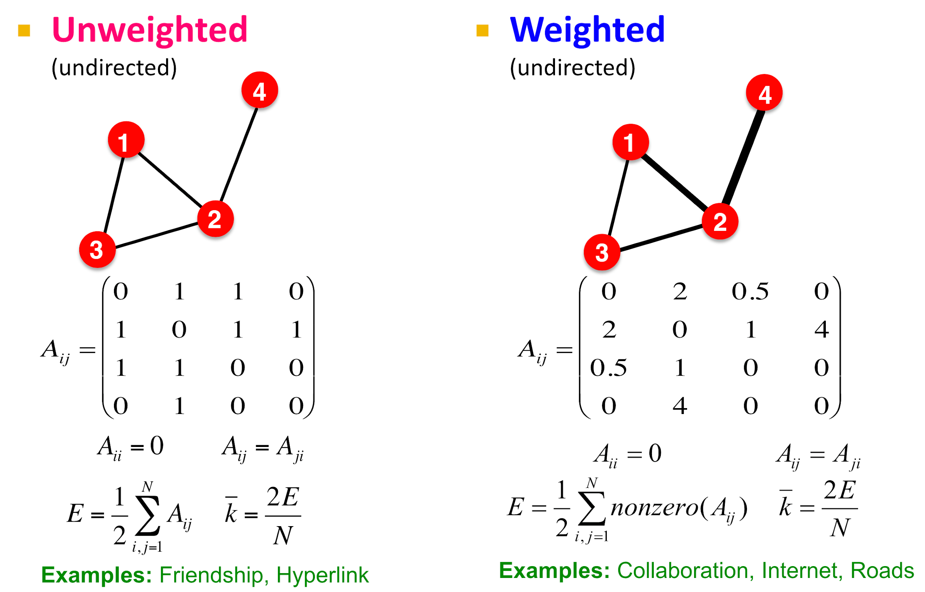
Types of graphs: weighted
Notes:
A real number (weight) is associated with each edge
…
Can come up with a notion of weights for nearly every graph. Your choice as the data modeler!
E.g., “friendship”: on FB unweighted; in real life: weighted

Slide 16
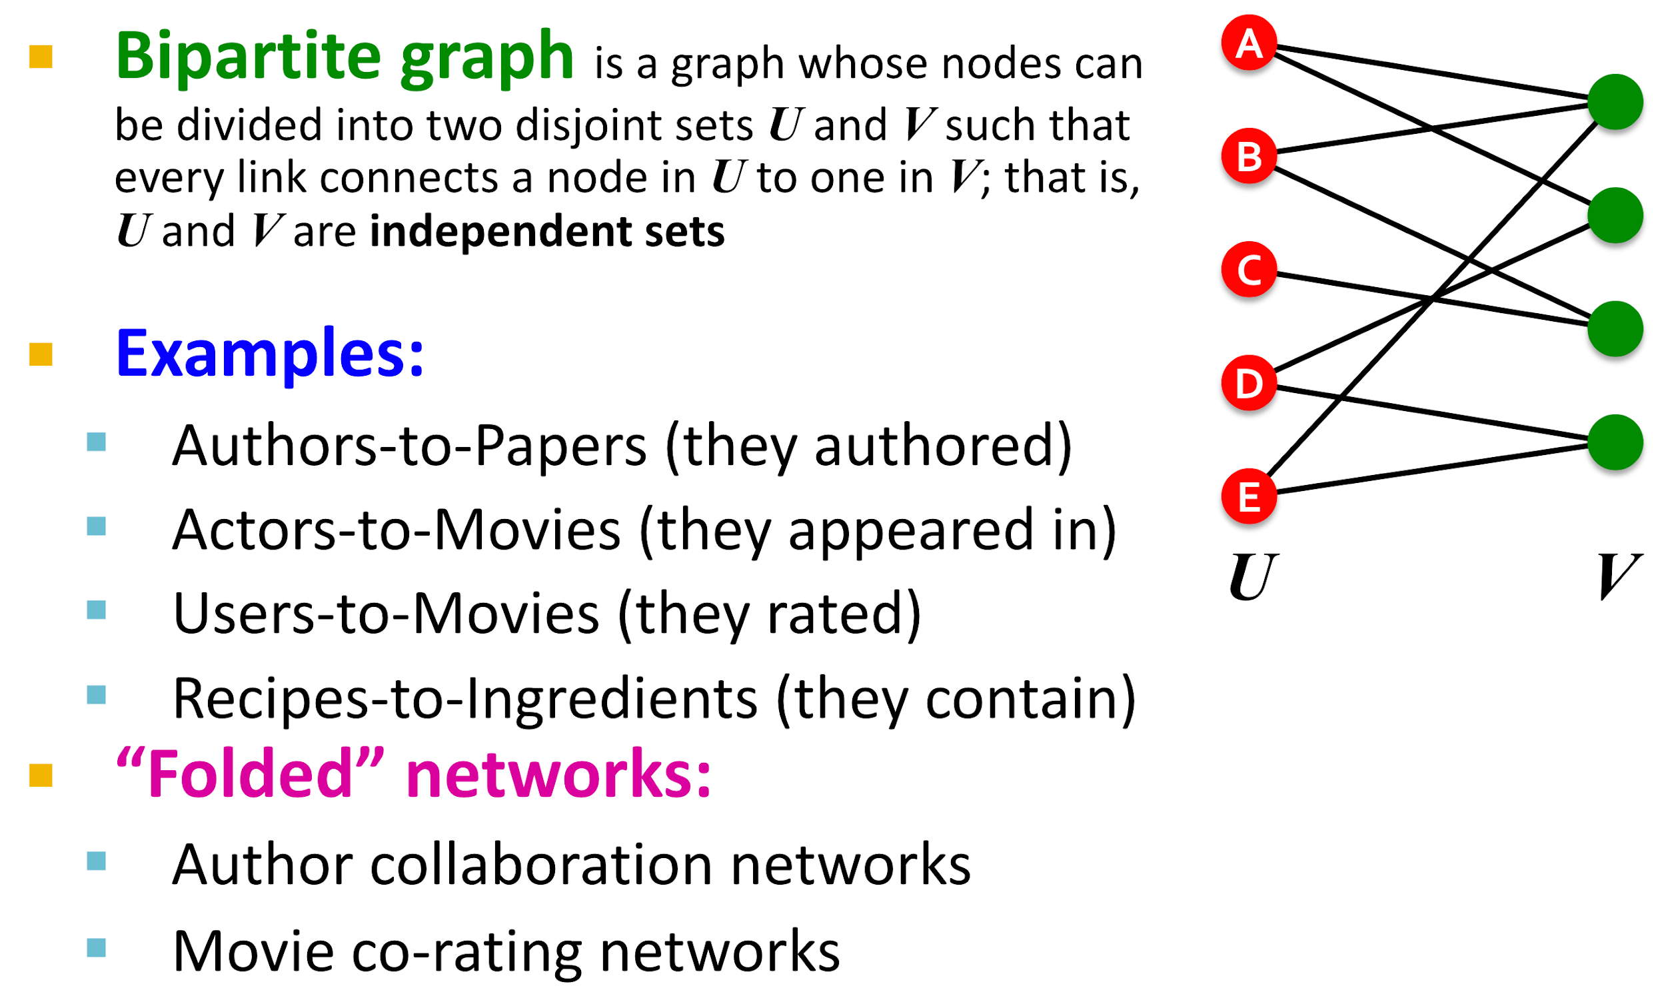
Types of graphs: bipartite
(a.k.a. “projections”):
Notes:
Folding a.k.a. projection
p.t.o.

Slide 17
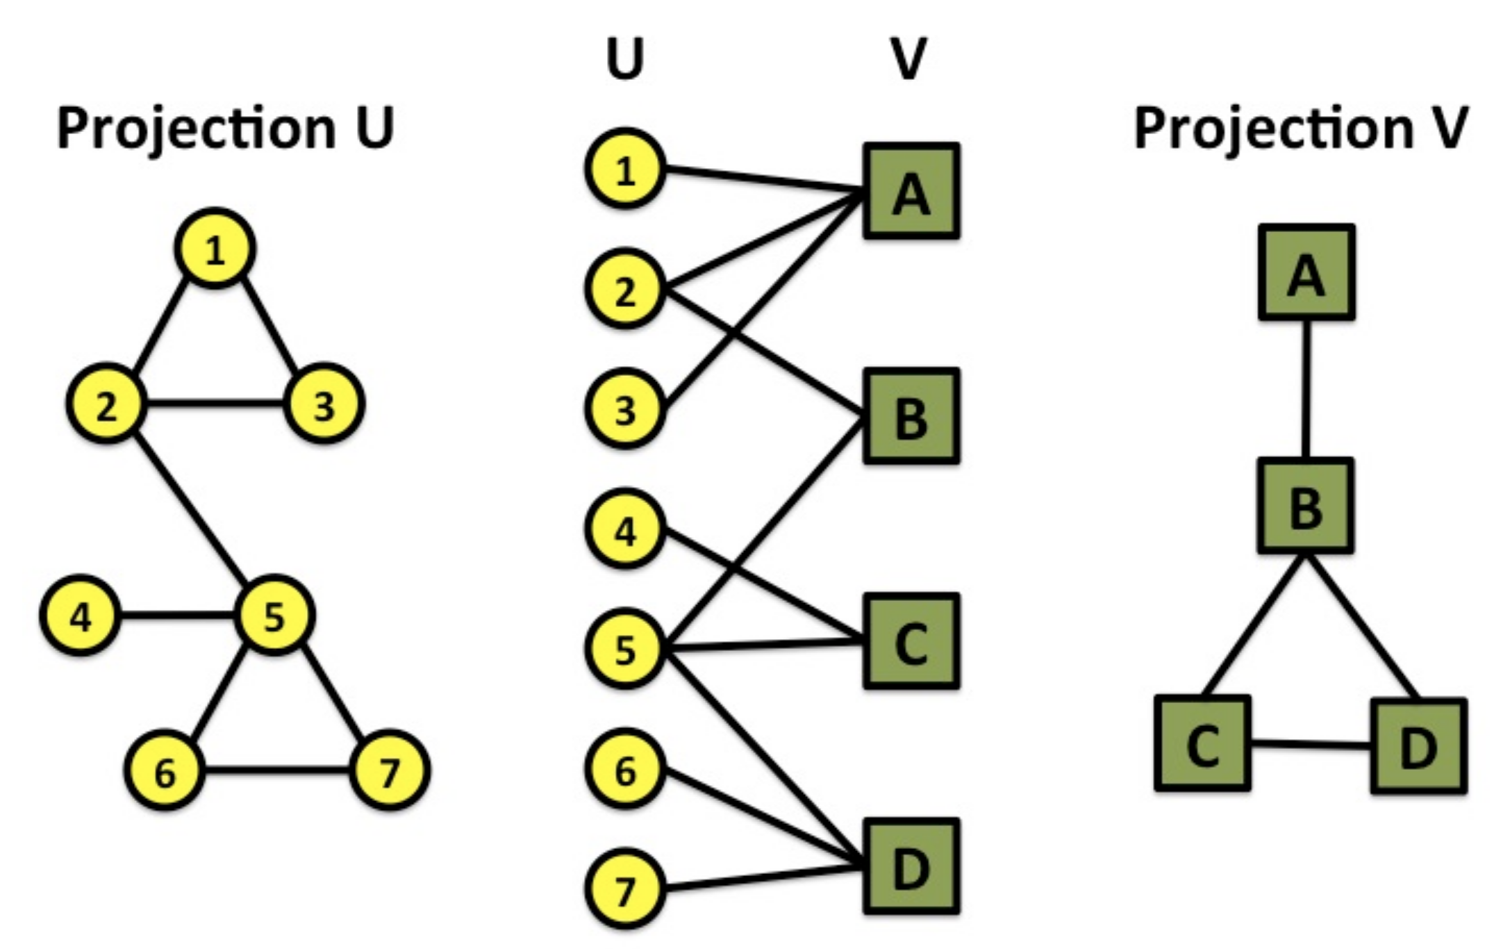
Projections of bipartite graph
Notes:
Edge in projection ⇐⇒ length-2 path in bipartite graph

Slide 18
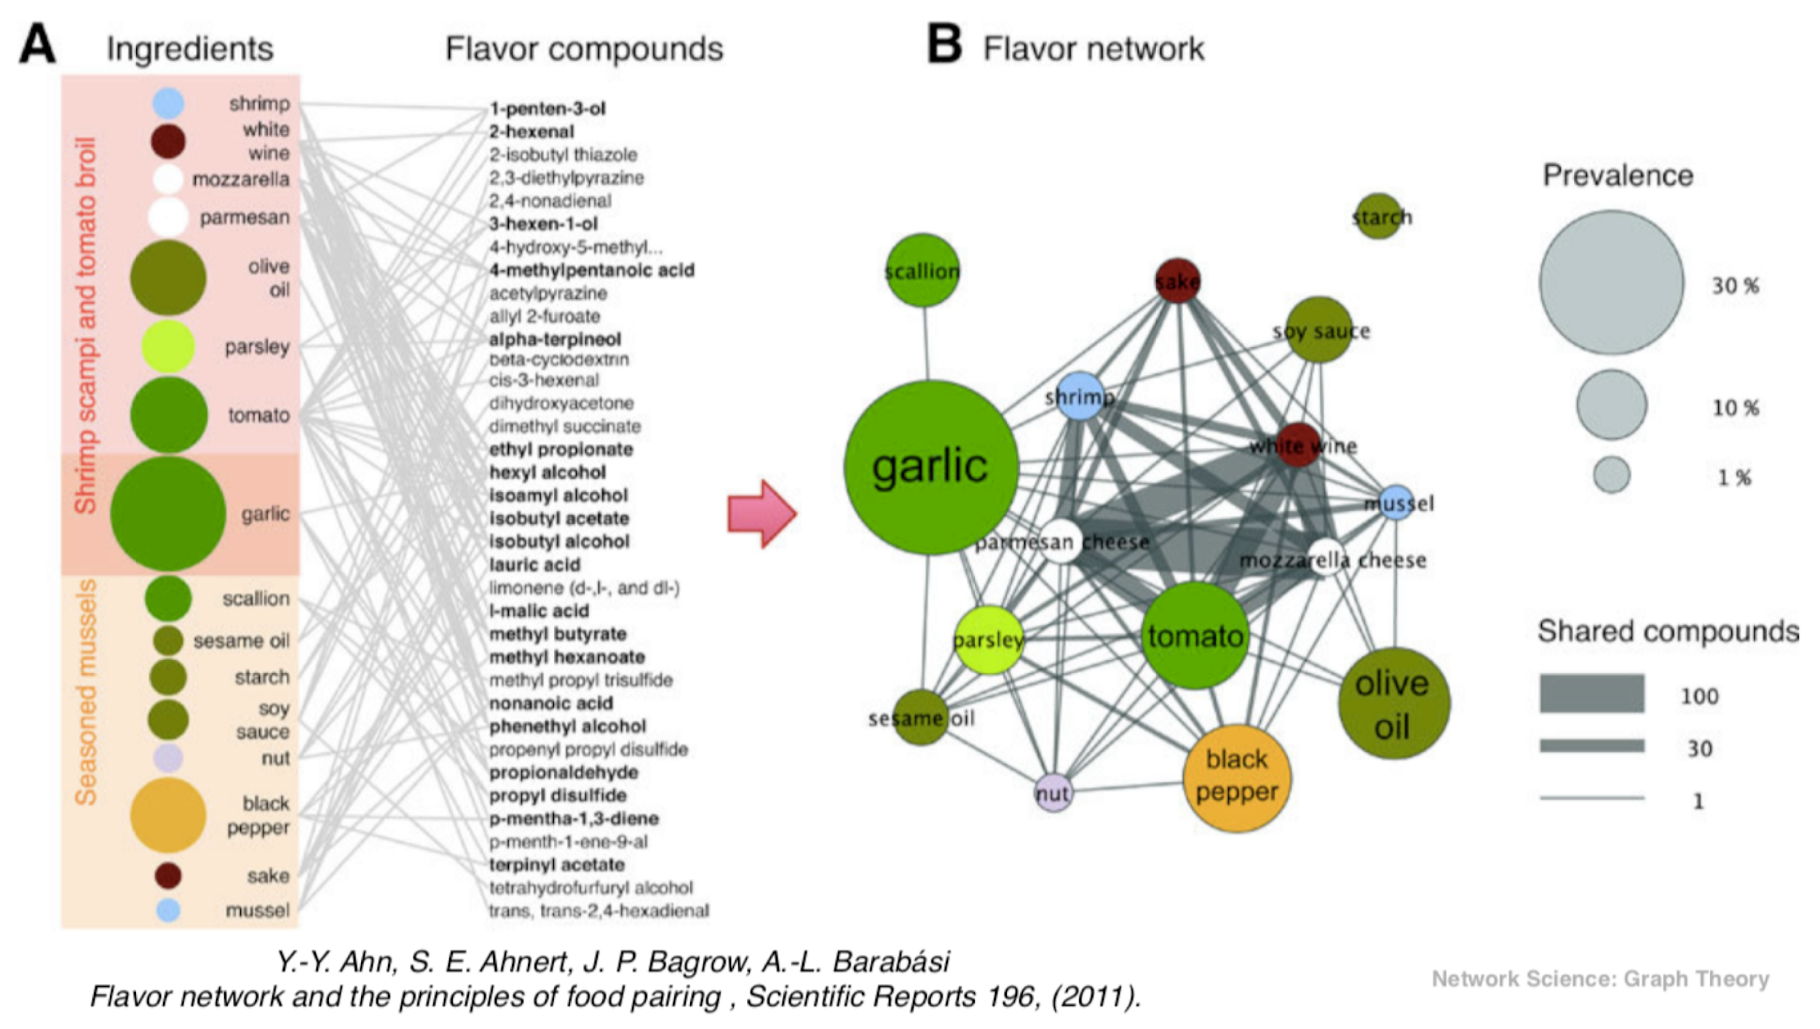
Example: flavor networks
[paper]
Notes:
One of my favorite networks
Here: Italian cuisine
Node size (“prevalence”) = %age recipes in which ingredient appears

Slide 19
Part 2:
Representing graphs on computers
Notes:
So far we treated graphs as mathematical objects only

Slide 20
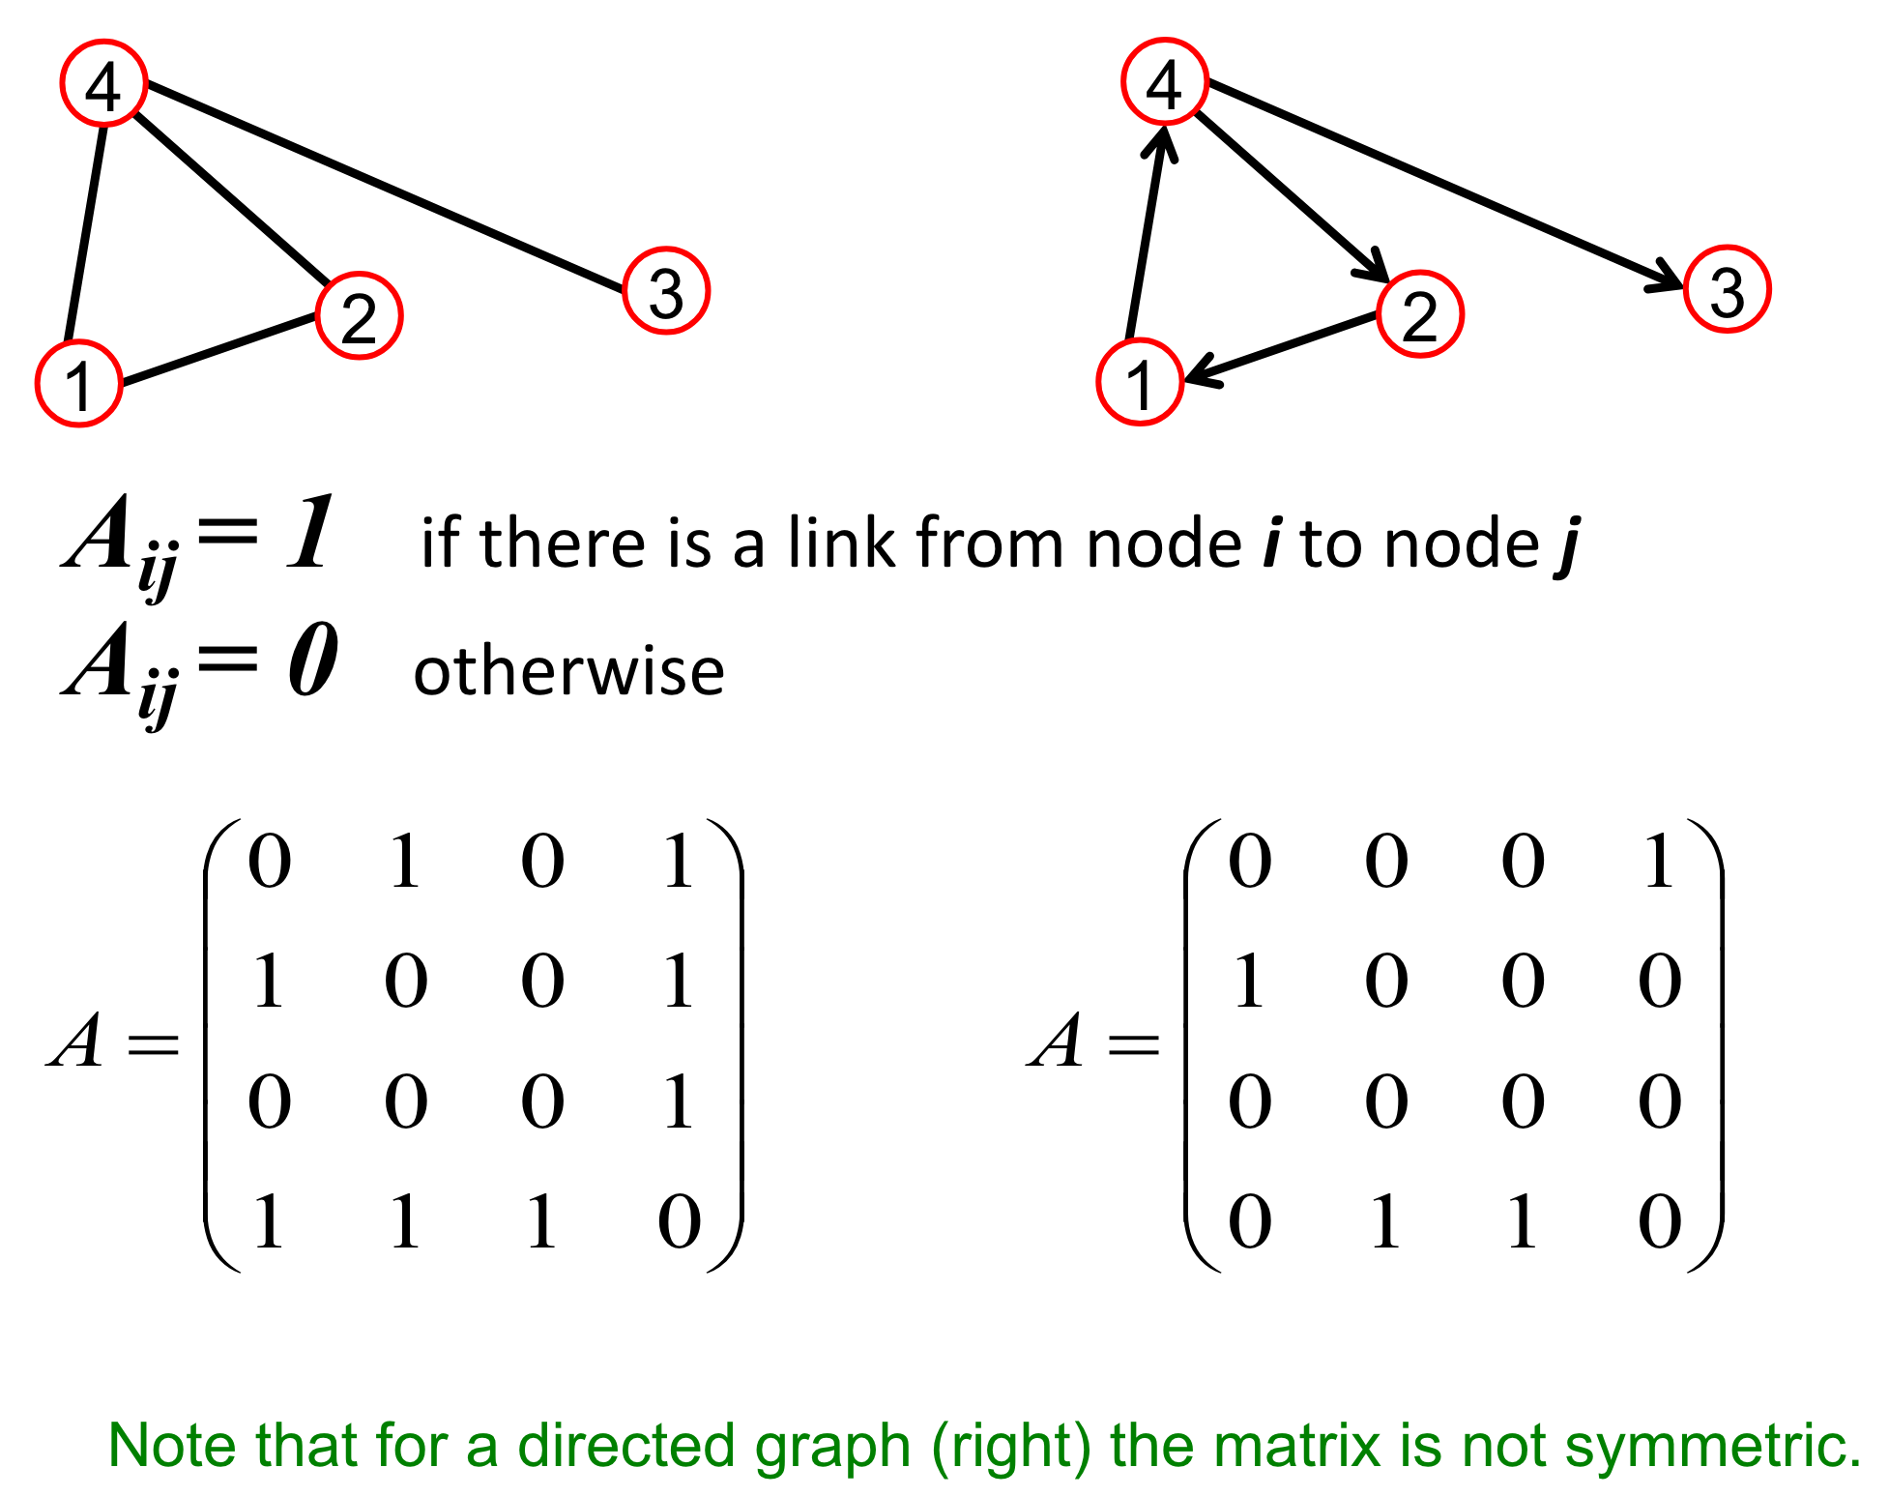
Representing graphs on computers: adjacency matrix

Slide 21
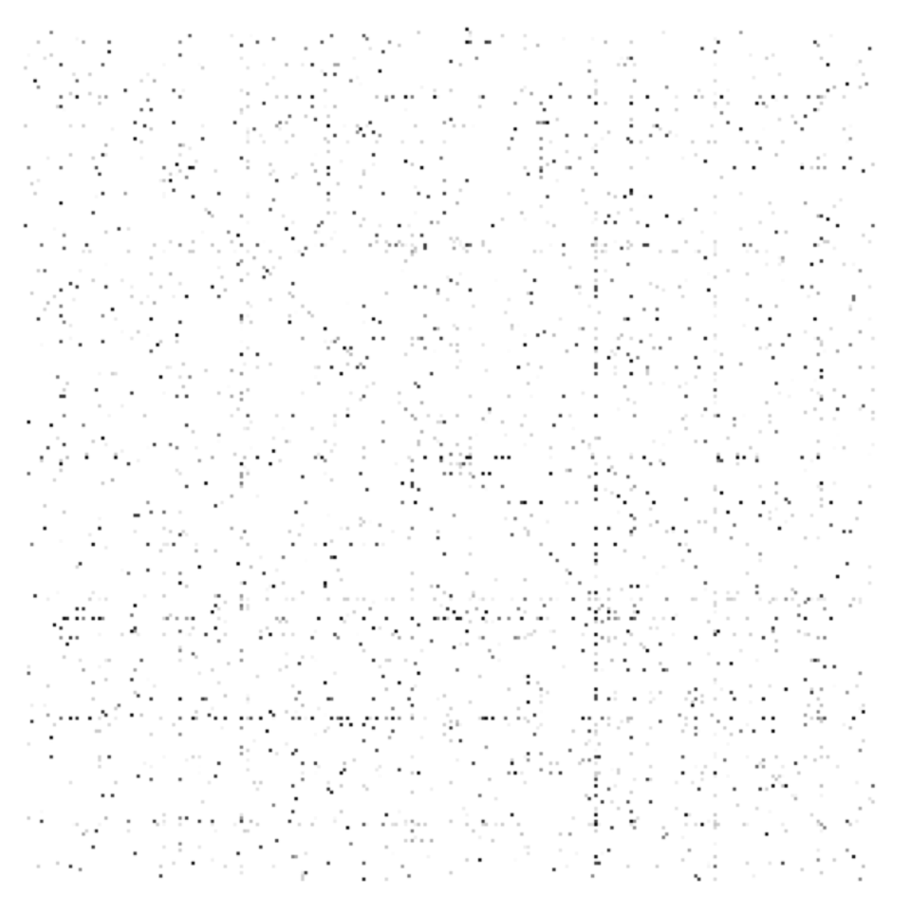
Adjacency matrix usually sparse
Notes:
Every node connected to only small fraction of all other nodes
Yet memory requirements same as for dense graph:
O(N^2)

Slide 22
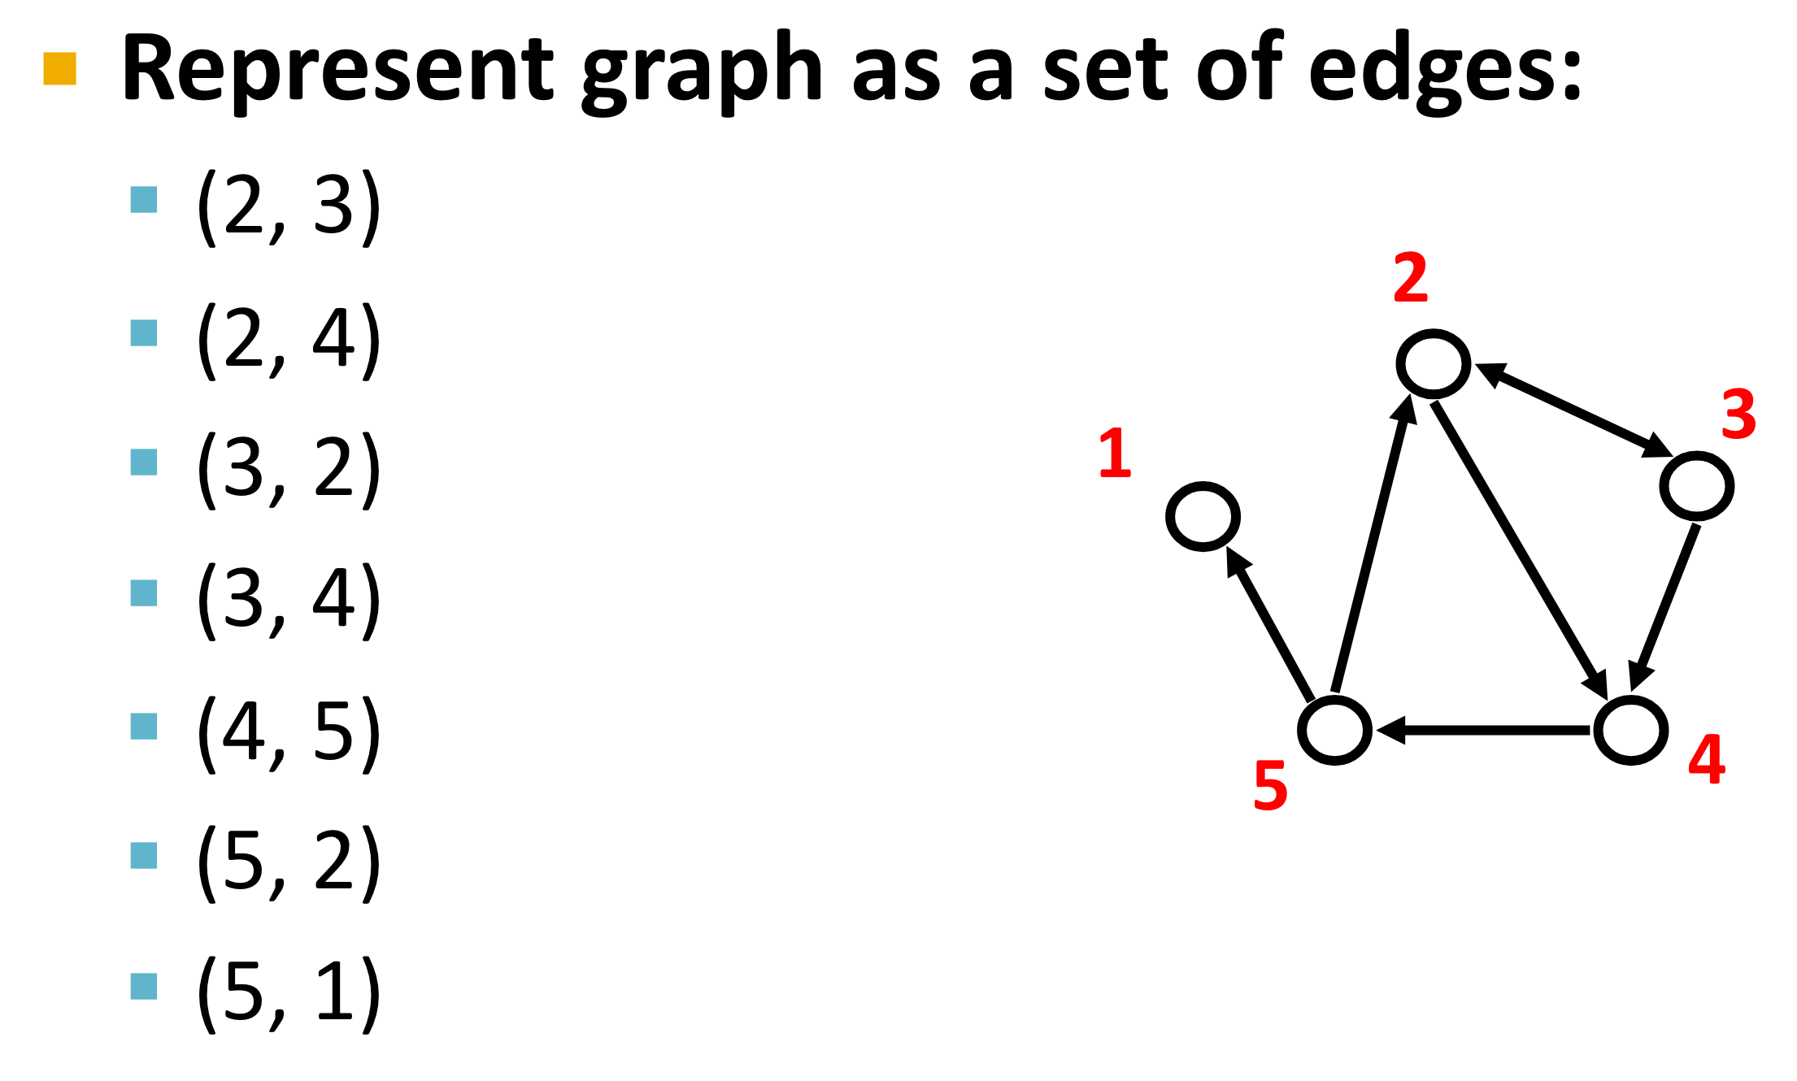
Representing graphs on computers: edge list
Notes:
Memory requirements:
O(E)
<< O(N^2) if graph every node has only few neighbors

Slide 23
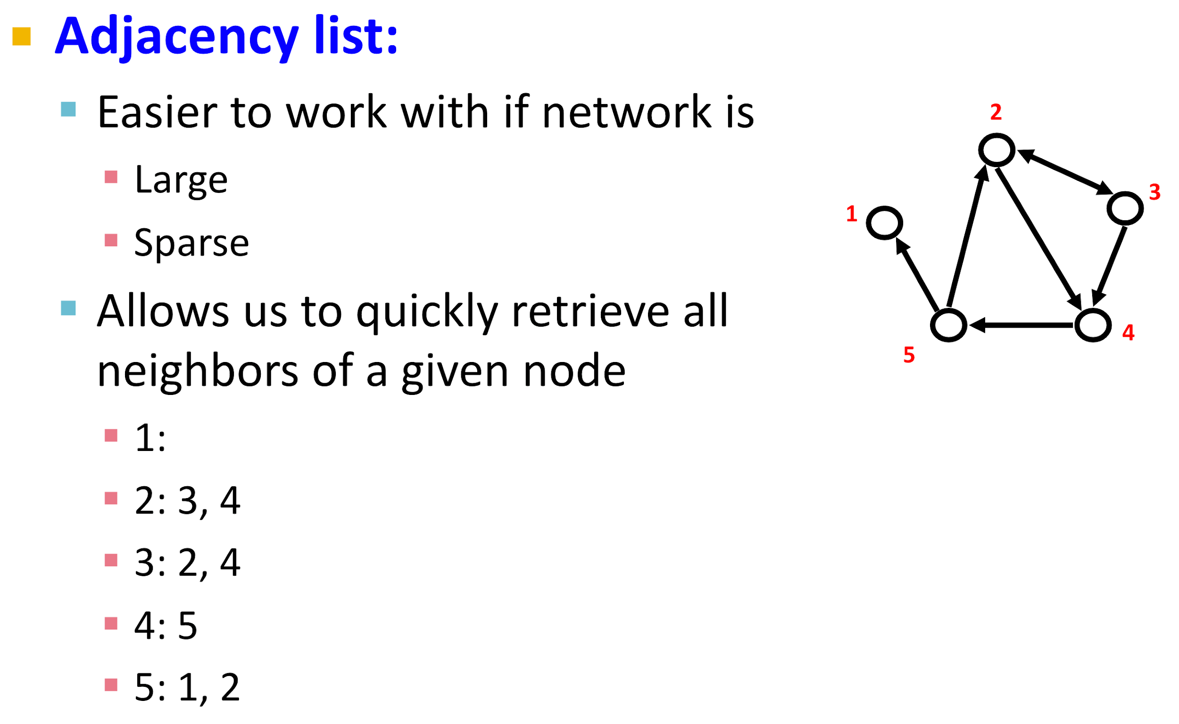
Representing graphs on computers: adjacency list
Notes:
Group all edges with the same source; list targets
…
If we also care about fast retrieval of inlinks for a directed graph: need 2 adjacency lists (in and out)
Graph processing software will take care of low-level implementation
but you still need to specify which implementation to choose, so need to understand advantages/disadvantages of each

Slide 24
Graph processing libraries
Good overview + benchmark available here
NetworkX
Written in Python
Popular but slow
Ok when your graph is small
This Friday’s lab session: intro to NetworkX
NetworkKit, SNAP, iGraph, graph-tool
Written in C++
Much faster than NetworkX
Libraries also available in other languages (incl. Python)
Consider these if your graph is large

Slide 25
Part 3:
Properties of real-world networks

Slide 26
Properties of real-world networks
Real networks are different from arbitrary graphs
Real networks tend to share certain properties
Remarkable, given the diversity of networks
Information networks (e.g., Web graph, knowledge graphs)
Social networks (e.g., Facebook, sexual networks)
Biological networks (e.g., protein–protein interaction)
…

Slide 27
Properties of real-world networks: sparsity
Every node connected to only small fraction of all other nodes
i.e., k_{i} ≪ N
Often bounded by a constant
e.g., social networks: Dunbar’s number (cognitive limit to the number of people with whom one can maintain stable social relationships; allegedly 150)
Notes:
…
But of course not all nodes have an equal number of neighbors
E.g., not everyone knows exactly 150 people
Some more, some less popular
→ degree distribution (p.t.o.)

Slide 28

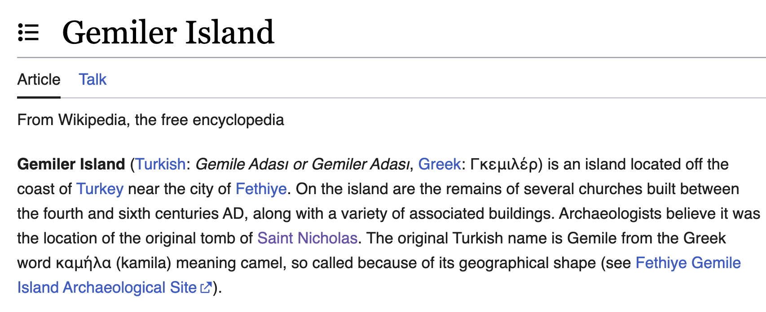
Infomercial break
Today!
And happy ADAvent to all of you!
Random wiki fact:

Slide 29
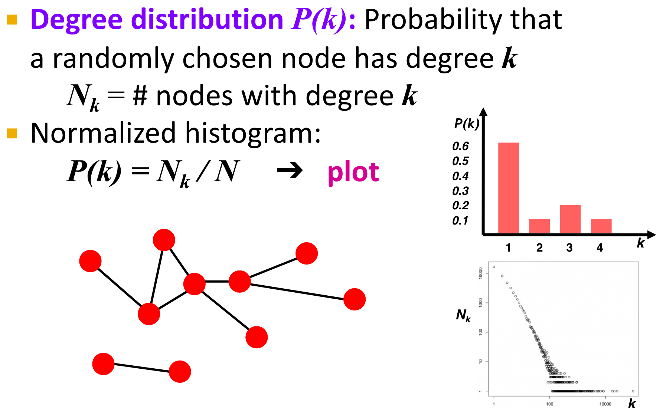
Properties of real-world networks: degree distribution
Notes:
This is a toy example
Real example: p.t.o.

Slide 30
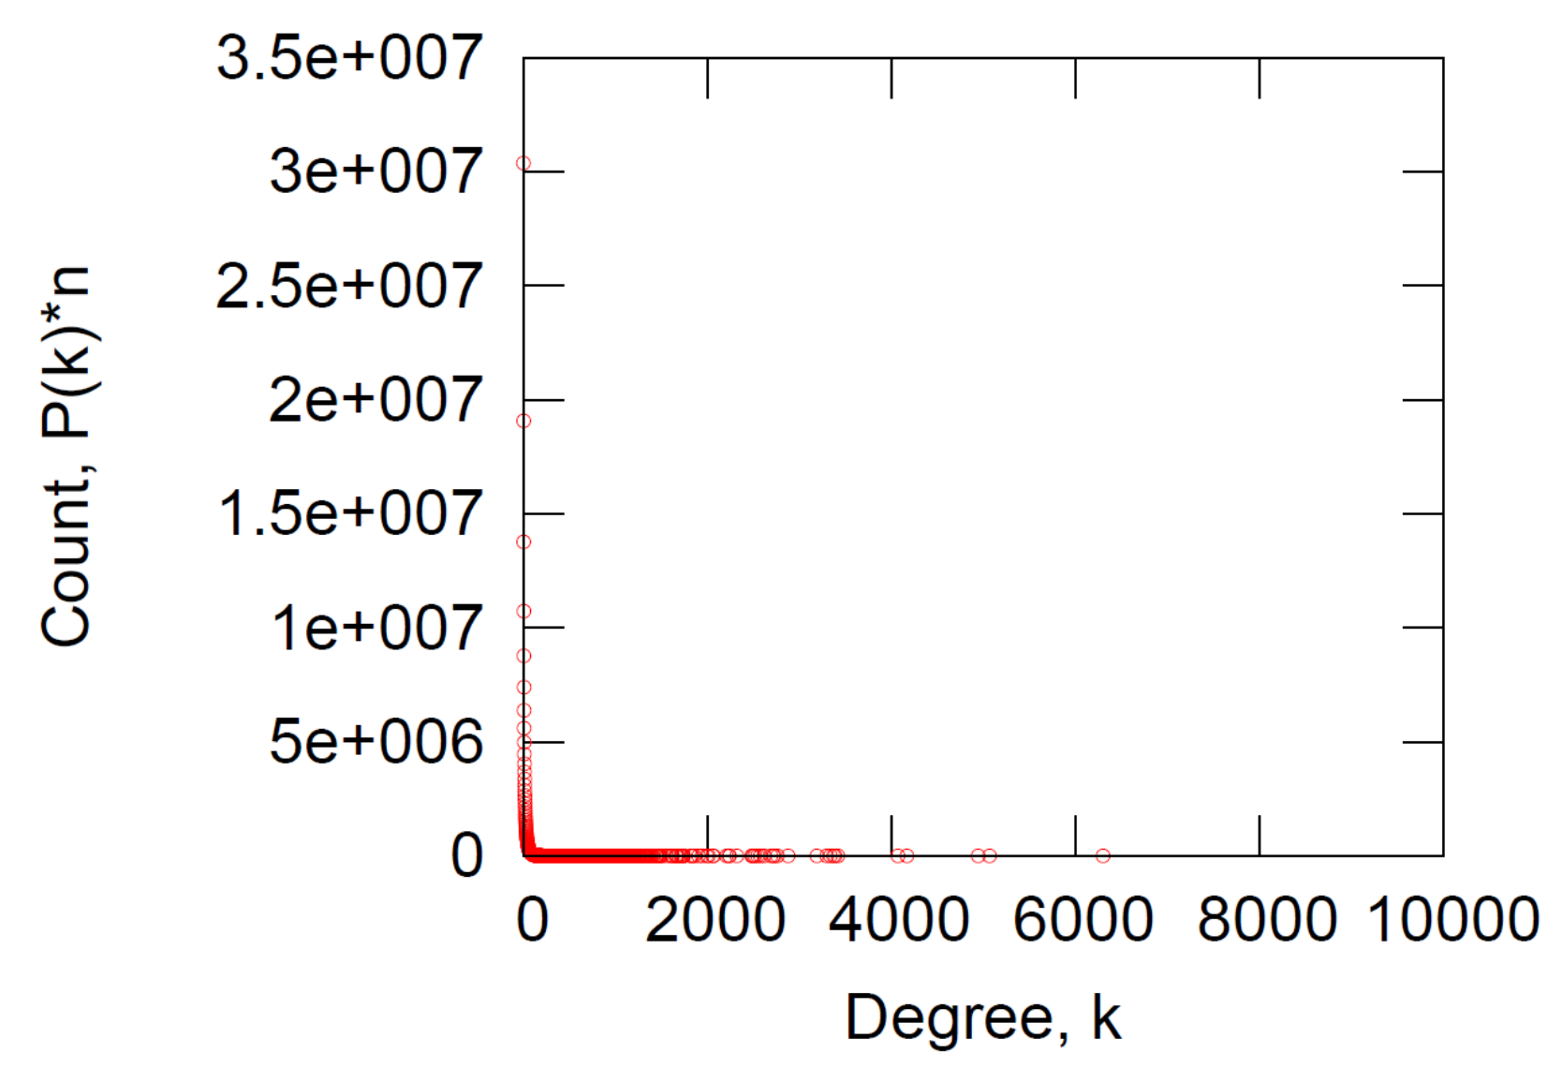
Properties of real-world networks: degree distribution
Notes:
Degree distribution of an online social network
Low degrees much more frequent than high degrees
E.g., social network: most people have few friends, some a lot
“Hubs”, “stars”
Spans many orders of magnitude
How to visualize it such that we can better see shape of curve?

Slide 31
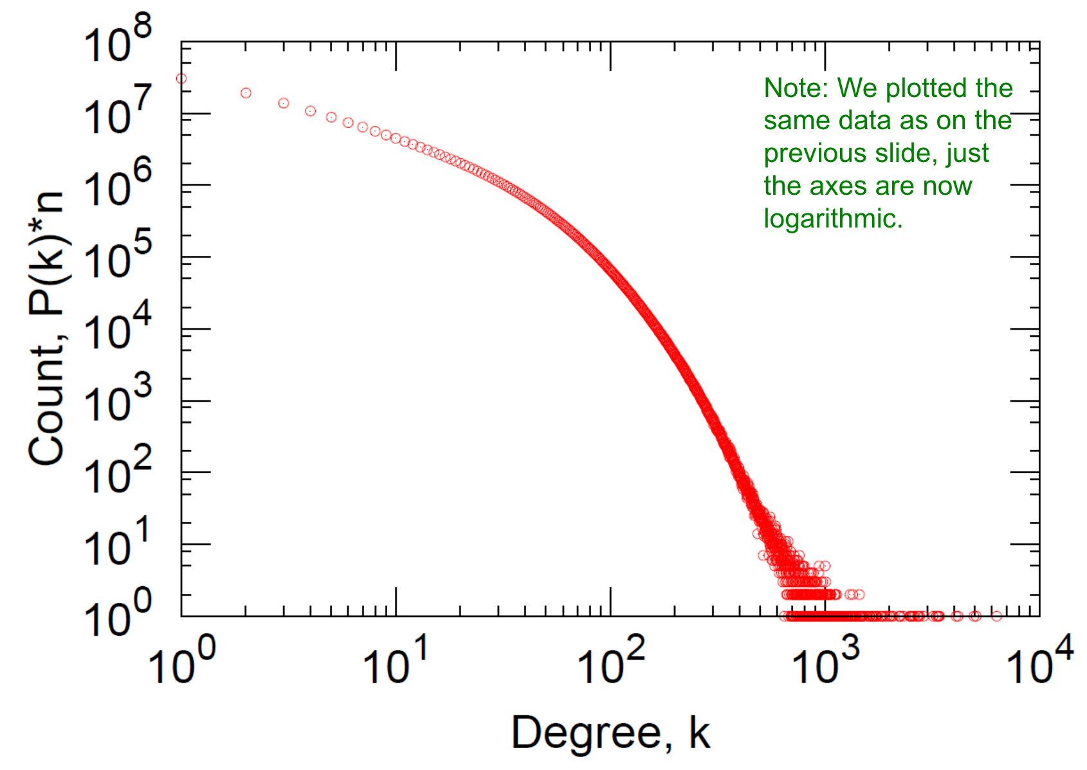
Properties of real-world networks: degree distribution
Linear axes
Logarithmic axes
Notes:
Spans many orders of magnitude
Need log-log plot (right) to even see anything
Tail ~= power law
(arithmetic) mean degree is actually not a good metric
What else to use? → median, quantiles, geometric mean

Slide 32
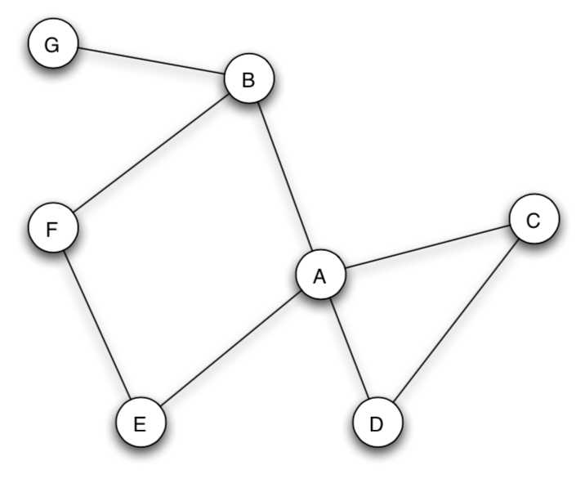
Properties of real-world networks: triadic closure
“A friend of my friend is my friend”
Measured via clustering coefficient C_{i} of node i: C_{i} = (#edges among neighbors of i) / (#potential edges among neighbors of i)
#potential edges among neighbors of i in undirected graph: k_{i} (k_{i} – 1) / 2
C_{A} = 1 / (4*3/2) = 1/6
In real networks, nodes have large clustering coefficients
Notes:
Don’t count “ego” node (e.g., A) itself

Slide 33
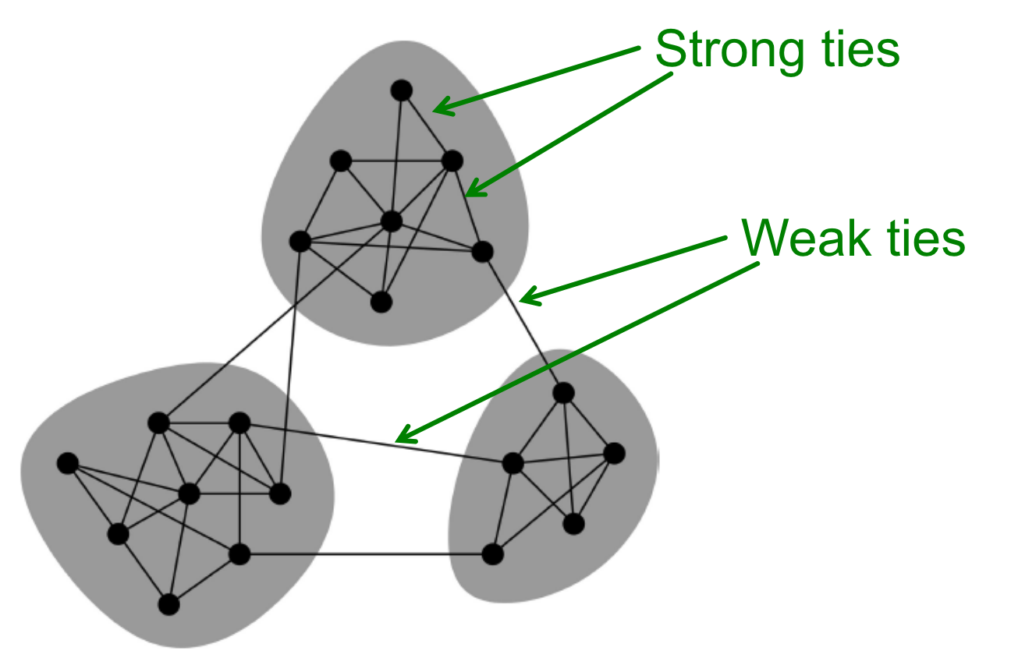
Properties of real-world networks: community structure
Triadic closure makes real networks cluster into locally dense “communities”
Communities connected via “weak ties”
“The strength of weak ties” (Granovetter 1973)
Weak ties fill “structural holes”
Notes:
One of the most cited papers of history (68k citations)

Slide 34
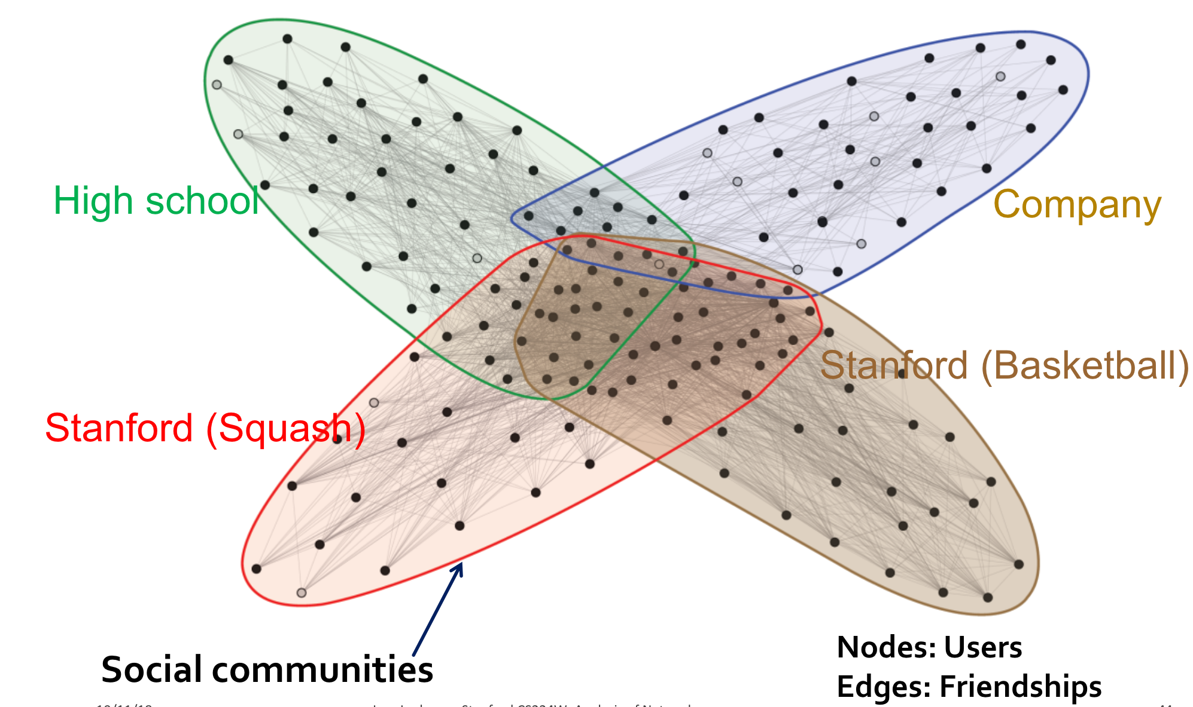
Properties of real-world networks: community structure
In real life, communities are often not disjoint, but overlapping:
[George
Costanza’s
ideal world; unfortunately not realistic]
Notes:
One person’s “ego network” (i.e., subnetwork spanned by ego’s neighbors)
Not few, but many edges between communities!
But underlying mechanism still the same: triadic closure
[CLICK] Who watches Seinfeld? (p.t.o.)

Slide 35

Extra homework:
Start watching Seinfeld,
so you understand the “Worlds Collide” theory

Slide 36
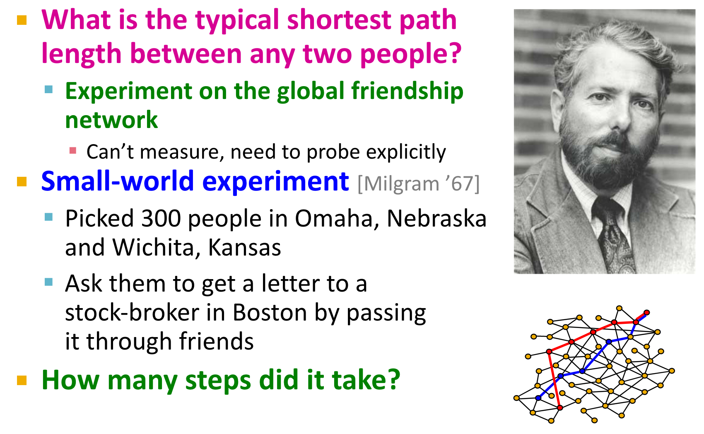
Properties of real-world networks: average shortest-path length
[Movie]
Notes:
Next property pertains to avg length of shortest paths b/w nodes
Investigation of this quantity goes back to Stanley Milgram, who asked: “What is …?”
…
Now we could measure it directly! (e.g., Facebook)
Nifty experimental setup: at every hop, mail postcard back to Harvard
Another famous “Milgram’s experiment”: electroshocks
→ Movie about him called “The Experimenter”

Slide 37
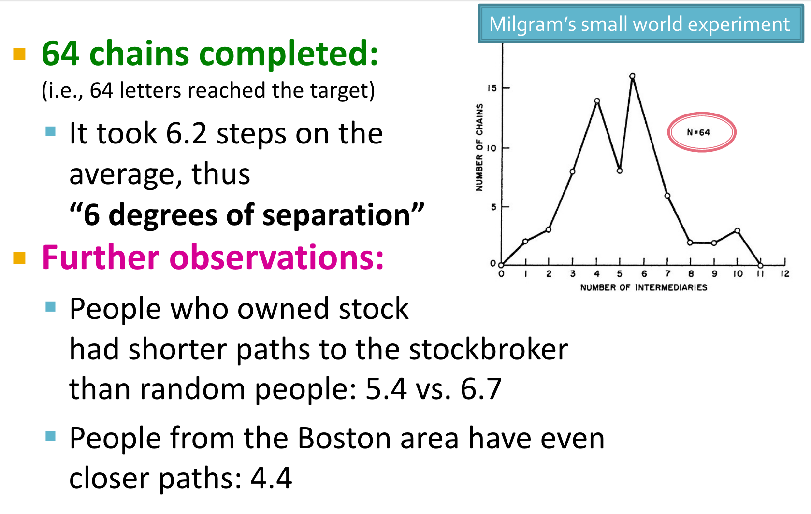
Properties of real-world networks: average shortest-path length
Notes:
“Degree” here not number of neighbors of a node, but length of a path (psych lingo)
…
Part of the reason: skewed degree distribution (“hubs”)
Look at the sample size! (64 out of 300 chains completed)
Methodological shrewdness because of absence of data
We should admire this!

Slide 38
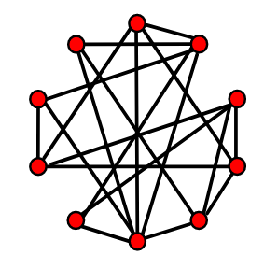
Properties of real-world networks: navigability
For decades, people focused on the fact that short paths exist in social networks
But this is true even in random graphs (e.g., Erdős-Rényi model)
The truly amazing fact is not that short paths exist, but that they are discoverable via greedy decentralized routing (as in Milgram’s experiment)
Intrigued? Read Jon Kleinberg: “The Small-World Problem: An Algorithmic Perspective”
Notes:
(explain ER)
Need precise mix between mostly short-range connections and a few long-range connections
Cf. flight networks
Bottom line: humans are good at findings paths through networks with a-priori unknown link structure

Slide 39
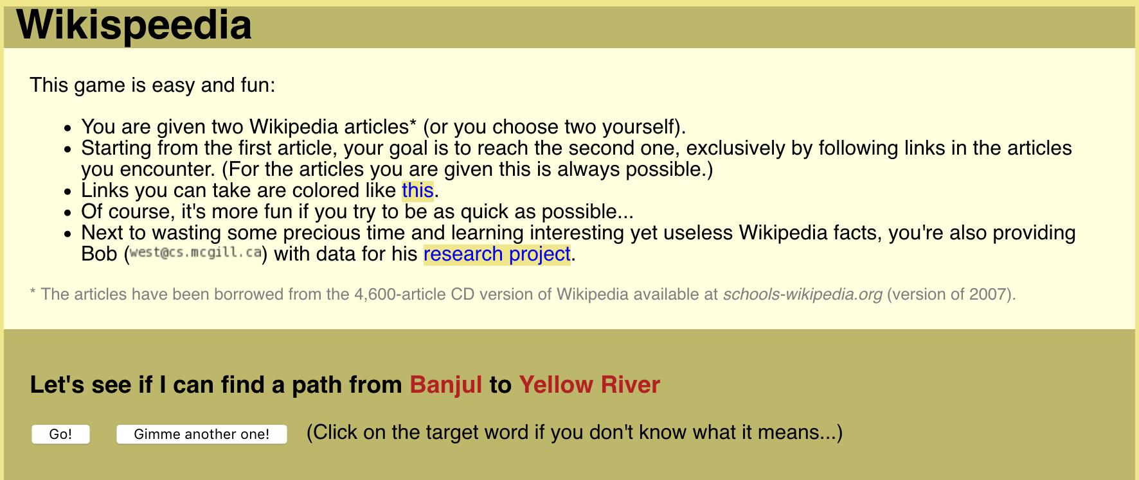
Don’t believe me?
Play a game and see for yourself how well you can navigate an a-priori unknown network:
Wikispeedia.net
Notes:
(if time, play an instance)
Similar to small-world experiment, but same person stays in control along entire chain

Slide 40
Properties of real-world networks: homophily/heterophily
“Birds of a feather flock together”
Especially in social networks
Big confound and cause of debate: Influence vs. homophily
E.g., obese people’s friends are more likely to also be obese
Influence: I copy eating behavior of those around me [argument for influence]
Homophily: people with similar eating behavior prone to become friends [argument for homophily]
Notes:
Influence: “obesity is contagious”

Slide 41
Properties of real-world networks: summary
Real-world networks (across many types)
are sparsely connected,
but some nodes are much more connected than most others (i.e., skewed degree distribution);
form locally dense clusters via triadic closure,
which leads to community structure;
have short paths between random node pairs (partly due to “hubs” [skewed degree distribution!]),
and the short paths are easily discoverable.

Slide 42
Part 4:
Measuring node importance

Slide 43
How to measure “importance” of a node?
Formalized via centrality measures
Map each node i to a scalar value C(i) capturing its importance in the overall network

Slide 44
Degree centrality
Simplest centrality measure
Many neighbors → important node
C(i) = number of neighbors of i
Very brittle, easy to “rig”
E.g., Twitter: scam account, followed by 100,000 other scam accounts

Slide 45
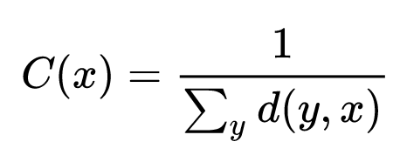
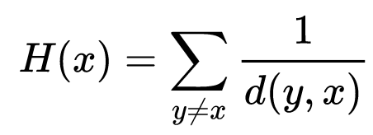
Closeness centrality
Farness(x) = total distance to x from other nodes
C(x) = 1 / Farness(x)
Reciprocal to turn farness into closeness
Only defined for connected graphs (otherwise d infinite)
Under closeness centrality, nodes that are easy to reach from anywhere in the network are considered important
Variant: harmonic centrality: switch sum and reciprocal
C(x) = total reciprocal distance of x to other nodes
Defined even for disconnected graphs (define 1/d of disconnected nodes as 0)
Notes:
Distance in unweighted graph: length of shortest path
Weighted graph: minimum sum of weights along any connecting path
Harder to rig than degree centrality (need to tinker with entire network)
(draw connection to harmonic mean: 1/C(x) = harmonic mean of distance to other nodes)

Slide 46
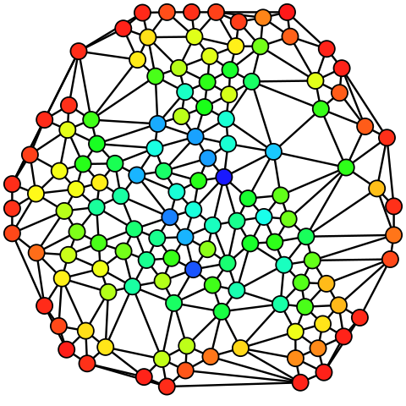
Betweenness centrality
C(i) = average fraction of all shortest paths in the network that pass through node i
Computation of betweenness centrality of node i:
For each pair of vertices (s, t):
Find all shortest paths from s to t
Compute the fraction of these shortest paths that pass through i
Average this fraction over all pairs of vertices (s, t)
Expensive to compute
Notes:
“Betweenness” sounds like an American state (Tennessee, Mississippi, Massachusetts)
…
Picture: blue = high betweenness, red = low betweenness
NOTE: real networks don’t look like this picture (planar graph, no hubs)
[Note: “average” in first line of slide is macro-avg (every pair gets same weight in avg)]

Slide 47
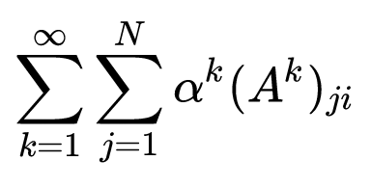
Katz centrality
Generalization of degree centrality
Degree centrality counts only number of direct neighbors (i.e., neighbors at distance 1)
Katz centrality also counts neighbors at distances 2, 3, …
More precisely, number of paths from other nodes to i, giving less weight to larger distances:
More robust than degree centrality
k-th power of adjacency matrix A contains number of length-k paths for each node pair
C(i) =
Notes:
Matrix power fact: easily seen by induction
Degree centrality when replacing infinity with 1
[Converges for α small enough (less than reciprocal of absolute value of largest eigenvalue of A...)]

Slide 48
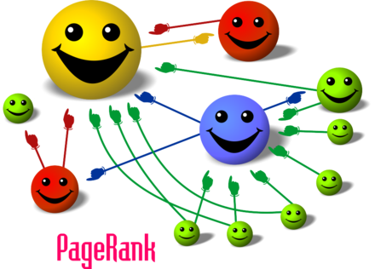
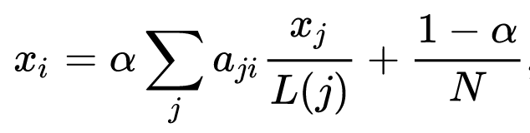
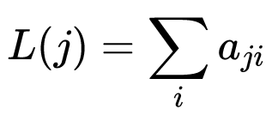
PageRank centrality
Recursive definition: my centrality C(i) =: x_{i} is high if I receive inlinks from many other central nodes:
Some extra tweaks to make it work with any graph (e.g., disconnected)
a_{ji}: entry (j, i) of adjacency matrix A (1 if j links to i,
else 0)
L(j): out-degree of j

Slide 49
PageRank centrality
Matrix notation: x = M x (where M is computed from adjacency matrix A)
Do you recognize this?
x is eigenvector of M with eigenvalue 1 → we’re in linear-algebra land (home sweet home)
x is the steady state the Markov chain induced by the network: x_{i} is fraction of time a random walker will have spent in node i, after a very long (→∞) random walk
Notes:
Computing M from A: normalize each row of A to sum to 1, then transpose
“Lalaland”

Slide 50

PageRank centrality
The technology that made Google huge
“Page” in PageRank for Larry Page
MapReduce (next lecture!) was invented to compute PageRank on full Google Web crawl
“The $25,000,000,000 eigenvector” [link]
Bottom line: Pay attention in your linear algebra class

Slide 51
Give us feedback on this lecture here: https://go.epfl.ch/ada2023-lec12-feedback
What did you (not) like about this lecture?
What was (not) well explained?
On what would you like more (fewer) details?
…

Slide 52
Credits
Some slides borrowed from CS224W class (Jure Leskovec, Stanford)

